Slide 1

Content Sifting Storage: Achieving Fast Read for Large-scale Image Dataset Analysis
Yu Liu¹, Hong jiang², Yangtao Wang¹, *Ke Zhou¹, Yifei Liu³, Li Liu¹
¹Huazhong University of Science and Technology
²University of Texas at Arlington
³Stony Brook University
Notes:
Hello everyone, It's a great honor to present this report to you at dac2020. My name is Yu Liu who comes from Huazhong University of Science and Technology. My reports’ name is Content Sifting Storage: Achieving Fast Read for Large-scale Image Dataset Analysis.

Slide 2
Introduction
Read latency for large-scale image data analysis
100 million images of size 1MB
SATA bandwidth = 220MB/s
5.26 days
Notes:
With the enrichment of data, users' requirements for storage system are not limited to saving data. For cloud storage, users need better storage system for the support of data analysis. However, existing support is primitive. Take 100 million images of size 1MB each for example, with the average sequential read bandwidth of SATA hard disk on the servers of company Tencent being around 220MB/s, it will take about 5.26 days to read these images. Obviously, it's too slow.

Slide 3
Introduction
Invalid read
Animal: 20.11%
People: 53.45%
Average
proportion
Vegetable: 20.11%
scenery: 20.11%
Notes:
Unfortunately, we find that not all images read from disks will be actually used for the given analysis. For the analyses of image content including animal, people, vegetable and scenery, the percentages of the relevant data in different datasets are averagely 20.11%, 53.45%, 17.01% and 29.43%. However, the storage system doesn't know this, so it has to read them all.

Slide 4
Introduction
Motivation
Sift first, then read
How to sift?
How to sift in the storage?
Notes:
Therefore, we think why don't we sift the relevant data before reading. Of course, there are two questions: how to sift? and how to sift in the storage system?

Slide 5
Introduction
Challenges
Relevance by content semantic
Expression ability for relevance
Search ability for relevance
Notes:
In fact, there are three challenges for ours. We should build relevance by content semantic in the storage system. And before that, we need to obtain the representations of expressing semantics. Note that, the simple label provided by users can not express the content semantic accurately for unstructured data, for example image. Last but not least, we need to build new structures to take advantage of this correlation. Obviously, the tree can't do this.

Slide 6
Introduction
Preliminary solution
Expression ability for relevance
Metadata
Similarity Hash Code
Notes:
Therefore, we solve them one by one. First, we should find representations to express content semantics. Similarity hash code is a binary vector which can express the images’ content semantics and occupies small space. It is fit for storage system and competent for the metadata. Moreover, it can build relevance by Hamming distance which computed by exclusive-OR.

Slide 7
Introduction
Preliminary solution
Search ability for relevance
Structure
Graph
Notes:
For another challenge about structure, we resort to Graph. Because relevance is wide and we should search all relevant data from center point. Of course, we should fine tune some details to fit storage system.

Slide 8
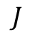

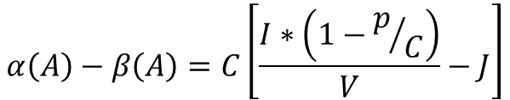
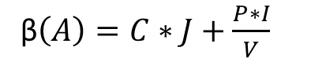
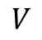
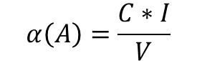

Methodology
Sifting time less than read time
$$α\left(A\right)=\frac{C∗I}{V}$$
β$\left(A\right)=C∗J+\frac{P∗I}{V}$
$$α\left(A\right)−β\left(A\right)=C\left[\frac{I∗\left(1−p/C\right)}{V}−J\right]$$
$$\frac{P}{C}$$
$$I$$
$$V$$
$$J$$
Notes:
With the plan, we first verify whether it is feasible in theory. If the sum of the latencies incurred by sifting and reading the sifted dataset is likely to be less than the read latency of the original dataset, then sifting becomes beneficial since, the more the unrelated data, the more bandwidth will be saved. We assume that the total number of images in a dataset is C, the number of relevant data for the given analysis A is P, the average size of an image is IB, the read bandwidth of disk is VB/s, and the latency for each image in content sifting is J s. α(A) denotes the latency of reading all data, and β(A) denotes the total latency of sifting all data (content) and reading relevant data. With the enrichment of data, α(A)-β(A) will increase. Therefore, our plan is valuable.

Slide 9
Methodology
Deep Self-taught Hashing
Notes:
For the acquirement of similarity hash codes, we apply Deep Self-taught hashing algorithm. First, it is an unsupervised deep hashing method. Second, it can metric each image with global view resulting in more precise hash codes. Finally, the hash code generated by deep model, which can ensure the efficiency in the storage system.

Slide 10
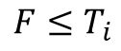
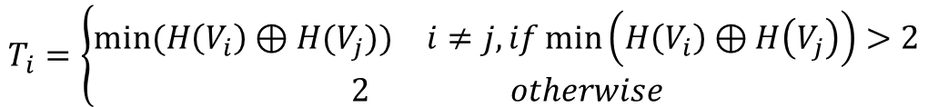
Methodology
Graph Construction
$$T_{i}=\left\{\begin{aligned}\begin{matrix}min⁡(H\left(V_{i}\right)⊕H(V_{j})) & i≠j, if\min\left(H\left(V_{i}\right)⊕H\left(V_{j}\right)\right)>2\end{matrix} \\ \begin{matrix}2 & otherwise\end{matrix}\end{aligned}\right.$$
$$F≤T_{i}$$
Notes:
For the graph in ours, we adopt restricted connection style. If there exists the weight of edge smaller than 3, we just connect edges whose weight is equal to 0,1 or 2. Otherwise, we just connect the edge whose weight is smallest. The principle of 0,1 or 2 is determined by results of DSTH paper.

Slide 11
Design
Content Sifting Storage
DSTH Model
Semantic Hamming Graph
File Storage
New Image Submit
Analysis Submit
Notes:
Now， we can introduce our content sifting storage. We call it CSS. CSS is mainly composed of three parts: DSTH model, SHG and file storage. DSTH model generates similarity hash code as embedded content metadata for each image. This embedding process occurs outside the critical path of user-oriented operations after the data are stored. SHG leverages Hamming distance and graph structure to organize the embedded content metadata. SHG can speed up the sifting process by clustering semantically relevant objects into adjacent areas of the graph. It can be updated incrementally since the relationships between former hash codes are certain and only new hash codes should be added to it. In the bottom of CSS, file storage reads a file by its name-path.

Slide 12
Design
Semantic Hamming Graph
Neo4j
four properties：hash code, file names, edge and note
four interfaces：insertion, edit, deletion and query
Notes:
The implementation of SHG in our prototype relies on a graph database Neo4j. For each node, we set four properties: hash code, file names, edge and note. For the graph operation, we set four interfaces: insertion, edit, deletion and query.

Slide 13
Design
New Image Submit
Notes:
When a new image is submitted, CSS first maps it to hash code by dsth model and then sends data with hash code to file storage. At last, file storage submits hash code with file name to SHG. If the hash code has existed, CSS will apply edit to complete record of file name. Otherwise, CSS will apply insertion.

Slide 14
Design
Analysis Submit
Notes:
For an analysis, CSS receives an image or images with sifting radii. CSS first transforms them to hash code and then sends them to SHG by query. CSS will find relevant file names to acquire entities in File Storage and then read them to users.

Slide 15
Evaluation
Settings
Datasets: ImageNet, MS-COCO and Tencent Album
Configuration:
two 10-core Intel Xeon E5-2640 CPU, 64GB DDR4 memory, and a single NVIDIA Tesla K40m GPU
8TB SATA hard disk whose sequential read bandwidth is around 500MB/s
Notes:
In the following, we will give the evaluation for above design. We test CSS on ImageNet, MS-COCO and Tencent Album. Our server has two 10-core Inter Xeon CPU and a single NVIDIA GPU. The read bandwidth is around 500MB/s.

Slide 16
Evaluation
Performance Comparison Varying Radius on ImageNet
Notes:
In the first test, we show the performance comparison varying radius on ImageNet. It is easy to find that 8 is the odd point for different requirements in first figure and the results of recall stop to increase. Meanwhile, the sifting latency is increasing. Therefore, 8 is best choice for radius on ImageNet. Note that the sifting latency is the results of accumulating 100,000 times queries.

Slide 17
Evaluation
Performance Comparison Varying Radius on MS-COCO
Notes:
The same test on MS-COCO are shown in these two figures. We find the best radius is 6 for different requirements.

Slide 18
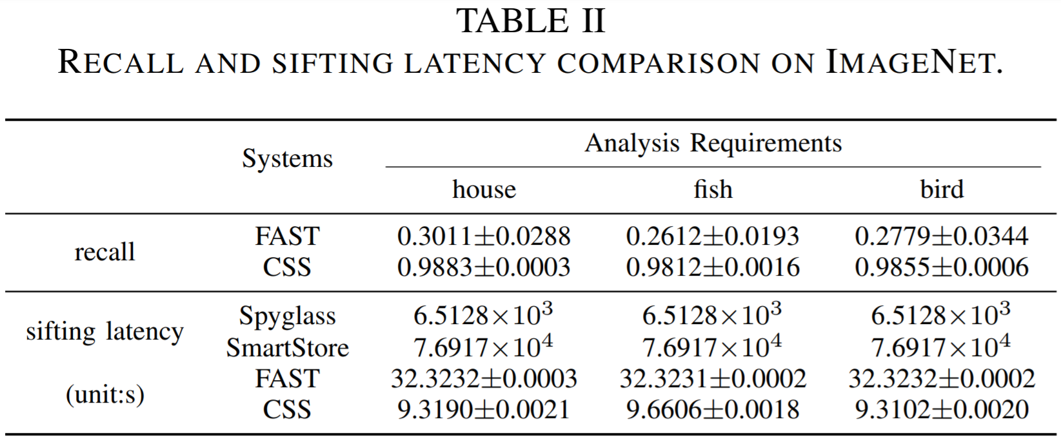
Evaluation
Performance Comparison with Semantic Storage Systems on ImageNet
Notes:
Furthermore, we compare CSS with other Semantic storage system in terms of recall and sifting latency on ImageNet. Note that, FAST applies LSH which is a hash function with global mapping. From the results, we find CSS has a higher recall and lower sifting latency. The advantage of recall shows the representation capture ability of our DSTH model. The advantage of sifting latency represents our superiority of design.

Slide 19
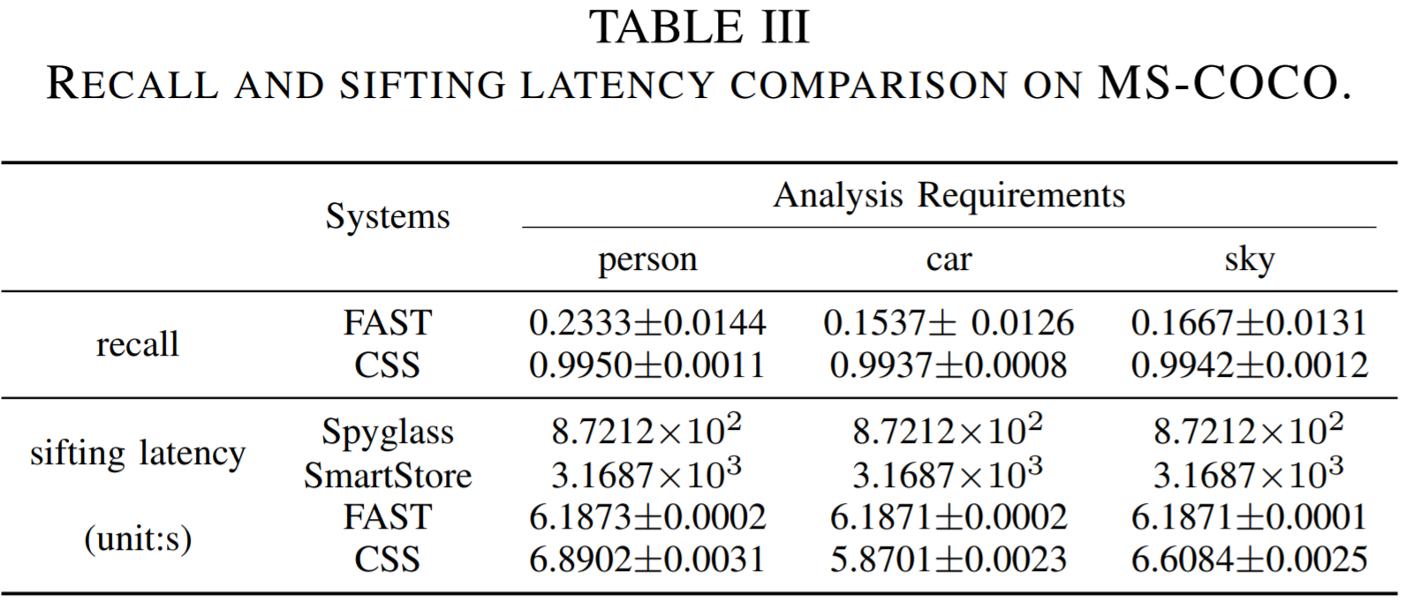
Evaluation
Performance Comparison with Semantic Storage Systems on MS-COCO
Notes:
The same advantage shows on MS-COCO. Note that some sifting latency on FAST is lower than CSS because the scale of MS-COCO is smaller than ImageNet. However FAST loss too much relevant data.

Slide 20
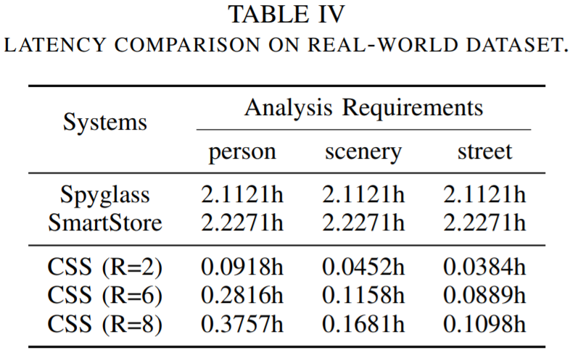
Evaluation
Performance Comparison with Semantic Storage Systems on Tencent Album
Notes:
To verify the practical effect, we test read time on Tencent Album whose size is around 5TB consisting of 1,000,000 images. With different radius, our read time is only 17.79%, 7.96%, and 5.20% of the shortest read latency of other systems respectively.

Slide 21
Conclusion
Hash metadata
Hash Graph
Content Sifting Storage
Reduce the read latency by 82.21% to 94.8% with more than 98% recall rate
Notes:
In this paper, we introduce deep similarity hash codes and weighted graph structure into storage systems, aiming at alleviating the latency caused by reading all data from the disks for large-scale image dataset analysis. We design CSS with embedded content metadata and SHG, which sifts the data meeting the analysis and indexes them to achieve fast reads. Extensive experiments on public and real-world datasets demonstrate the excellent effects of method compared with conventional semantic storage systems that CSS can greatly reduce the read latency by 82.21% to 94.8% with more than 98% recall rate.

Slide 22
Questions
Notes:
Thank you for your attention. Please ask questions.

